Slide 1
Market Research
Initial Results
Feb 8th 2017

Slide 2
Safety Wearable Device Research
Goal of the Research was to:
To check the overall acceptance and willingness to buy a safety wearable device in India.
Understand the target market in terms of demographics.
Price people are willing to pay
Test the ’Panic Experience’ Hypothesis

Slide 3
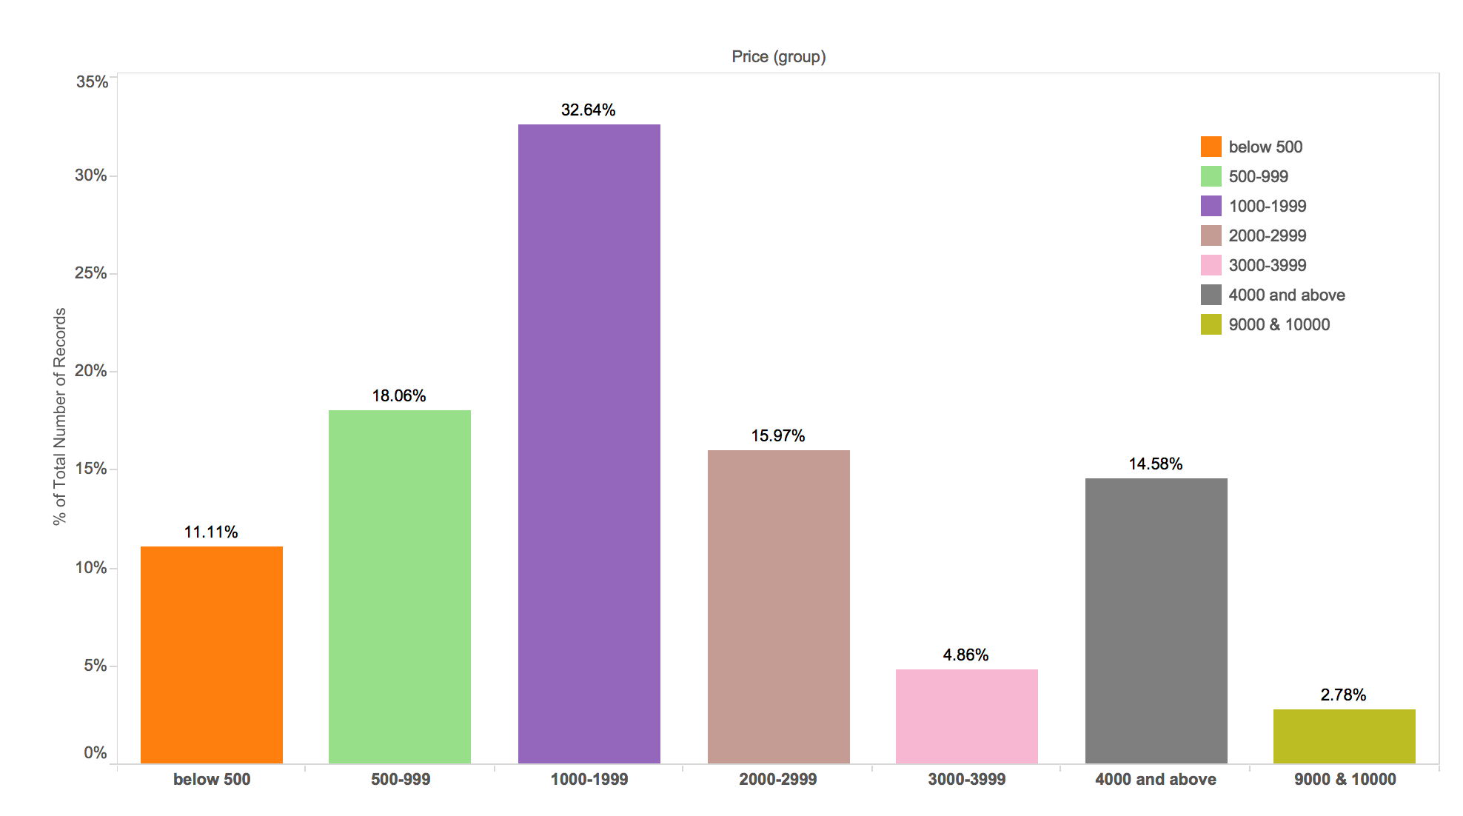
Overall Response and Price Range
Overall response was positive, 99% people were willing to buy the product.
“Rs. 1000-1999 ($15-$30)” was the most popular price range - 33% of survey population.
A good baseline - None of the product features were mentioned in the survey.
Note: Price ranges are in Indian National Rupee(INR).
Notes:
No. of respondents: 842
60% Female and 40% Male
90% Android Users

Slide 4
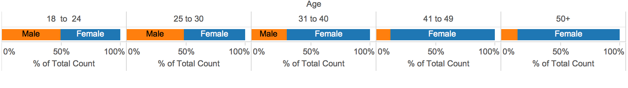
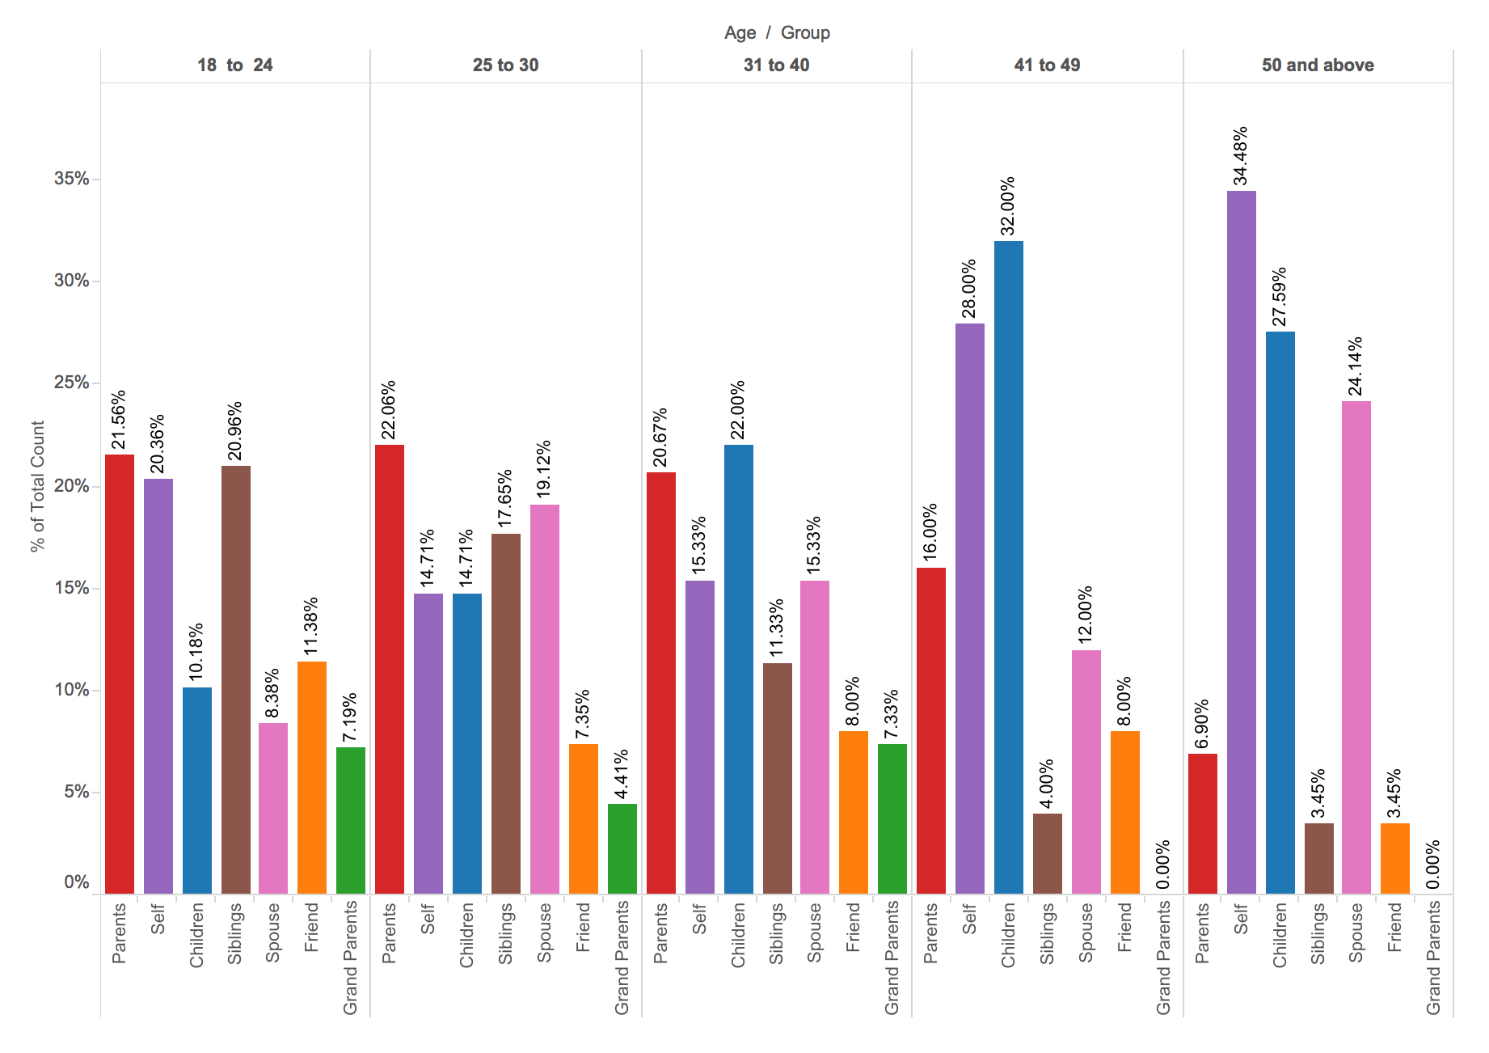
Target Age Range and Motive
‘Parents’, ‘Self’, ‘Children’ are popular reasons to buy the product.
Age range 31-40 is our ‘sweet spot’. They show a tendency to buy the product for parents and for their children.
A safer age range would be 25-49.
22%
20%
28%
15%
14%

Slide 5
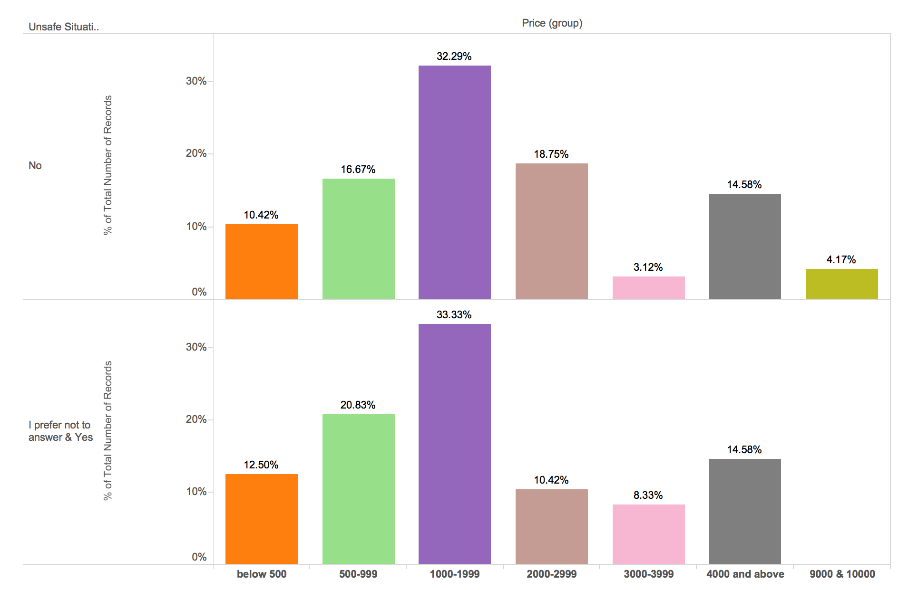
Motivation of ‘Panic Experience’
Hypothesis: People who have experienced ‘panic’ situation have higher tendency to buy/ pay more
Results: The market research did not show any such indication.
Distribution of responses by price range are almost identical in those who have experienced panic situation vs those who have not.
This could be a random chance as the sample set was small.
Note: Price ranges are in Indian National Rupee(INR).

Slide 6
Recommendations
Product Design:
Product design should also consider ‘parents’ and ‘children’ as factor to buy the products.
The clip-on should be friendly for children’s use.
Production & Marketing:
Cost of production should consider the price range (Rs. 1000-1999) for profitability.
Need to include product features in marketing, to get a lift over the baseline price range (Rs. 1000-1999).
Marketing should include target age range ‘25-49’.
Notes:
Ways to improve this analysis:
Better sampling method(stratified sampling) and higher sample size.
Including questions related to income group and comparing it to total Indian population.
Improving the questions with more description about the product
Automated method to pick location/ip
Research focused on hypothesis of panic event.
Experiments to improve response rate/ positions of the questions.

Slide 7
Thank You

